Slide 1

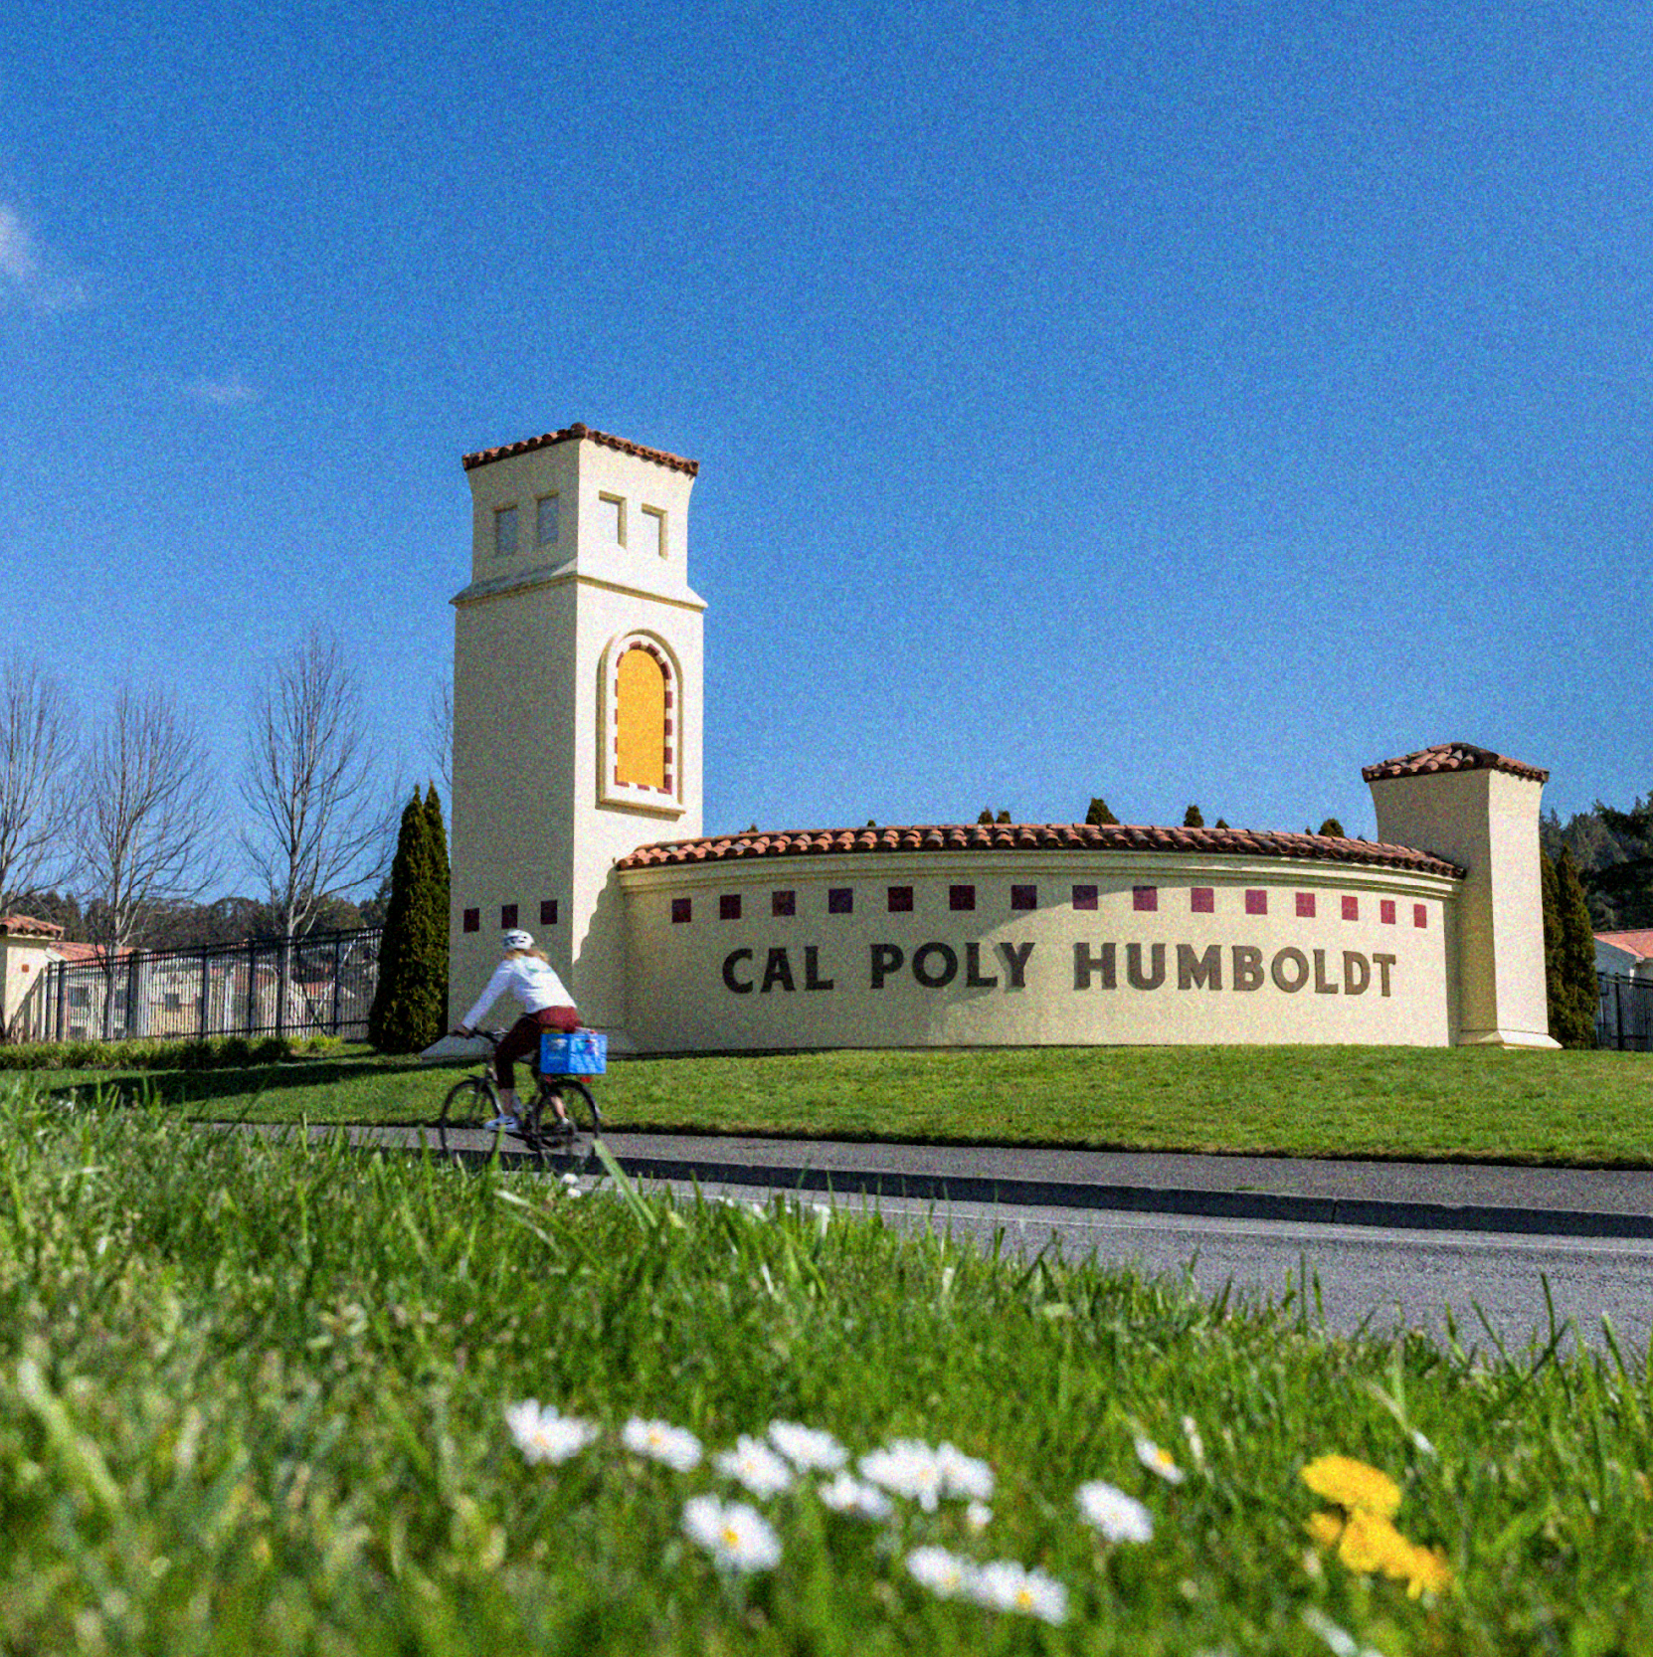
Data Science at Cal Poly Humboldt
Bethany Johnson
JMM Data Science Panel | 01/2025

Slide 2
Goals at Cal Poly Humboldt
Expose students to data science methods
Encourage a sense of curiosity and connection to their place
Embrace interdisciplinary thinking and collaboration
Data for good

Slide 3
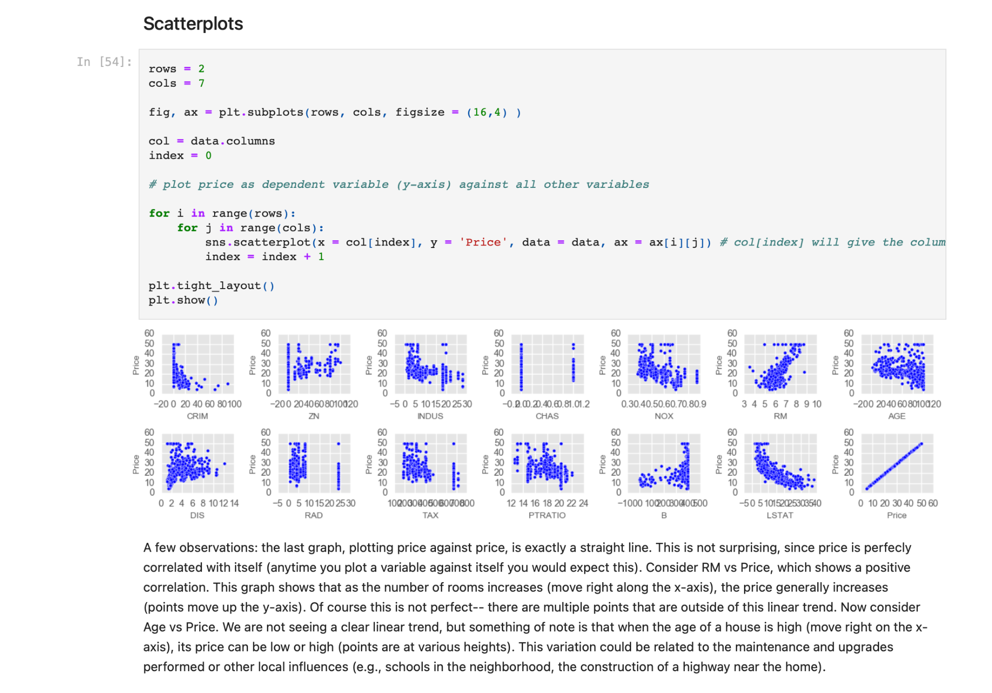
Technology: Jupyter Notebooks
Markdown, code, visualizations in one file
Pros:
Interactive
Enables reproducibility
Intuitive interface for new users
Cons
Can be resource intensive
Debugging

Slide 4
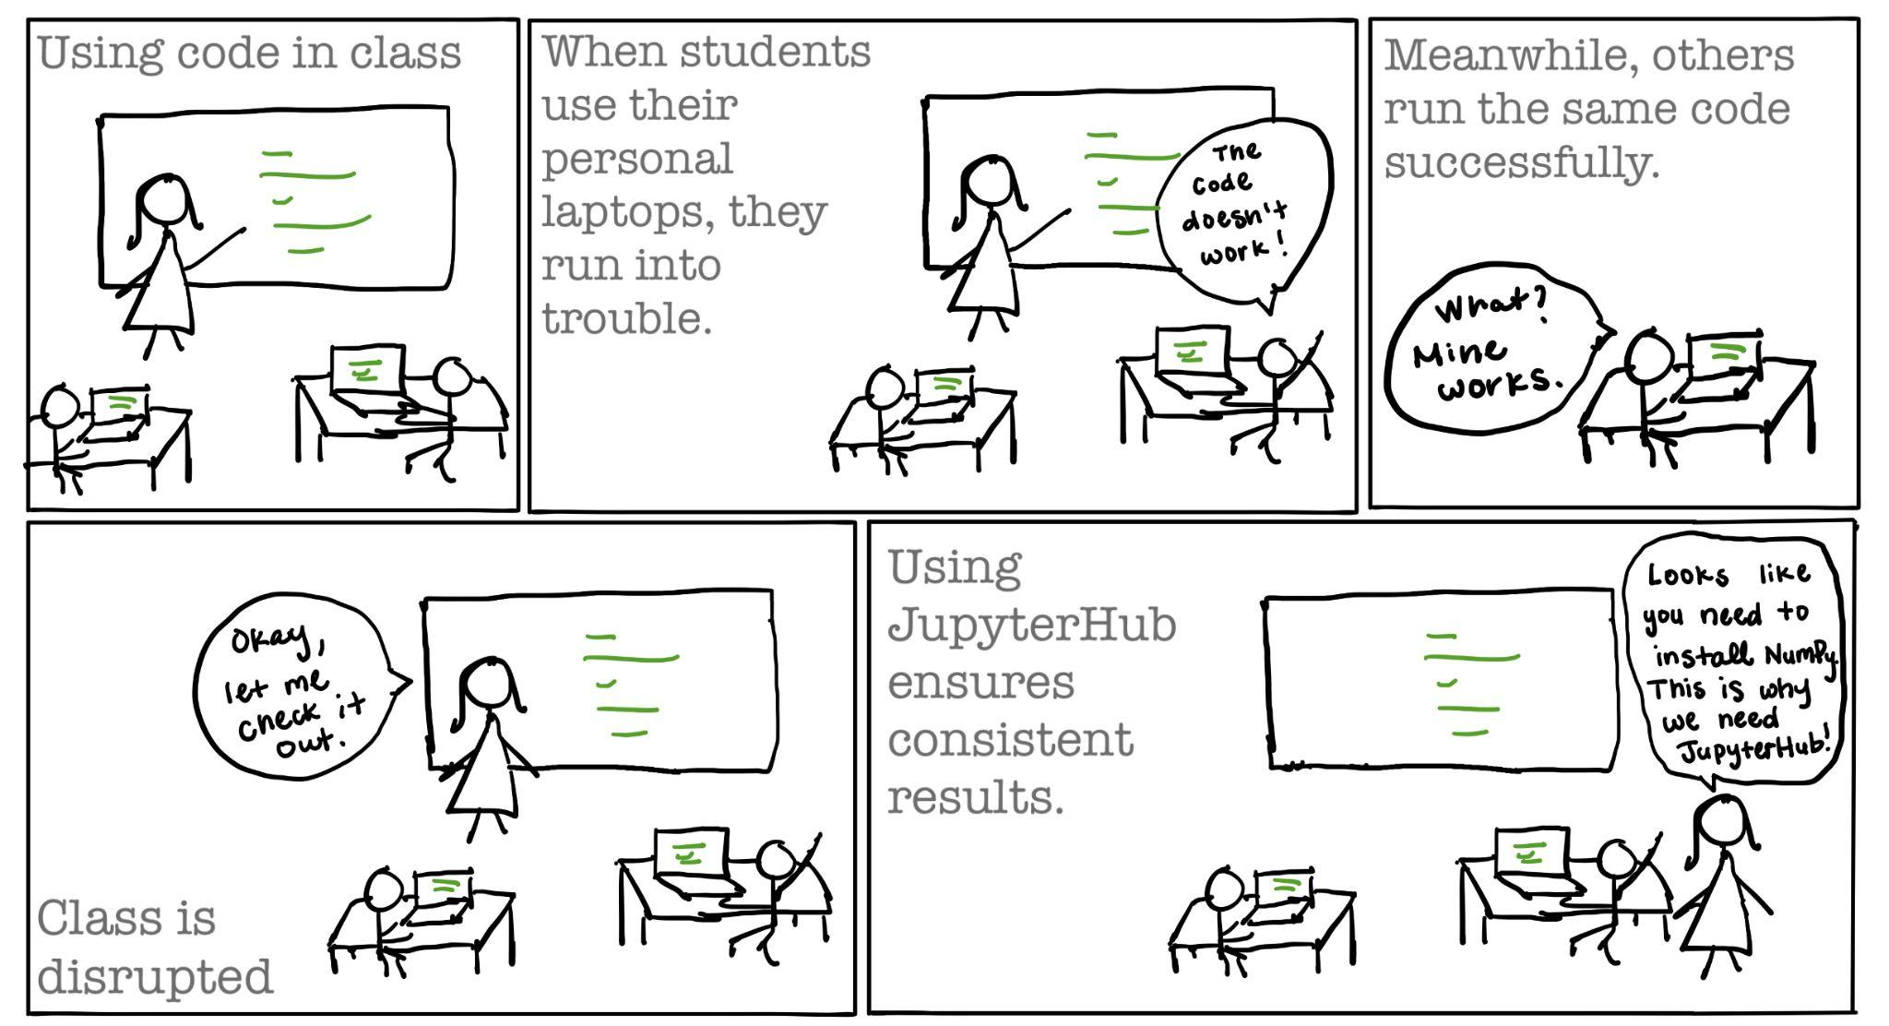
Technology: JupyterHub

Slide 5
Technology: JupyterHub
Pros:
Consistency across student environments
No local installations required. Ready to go on Day 1.
Students and instructors can work from anywhere (multiple devices without GitHub)
Supports multiple programming languages
Easy distribution
Cons:
Scaling compute power up or down can be challenging
Centralized management

Slide 6
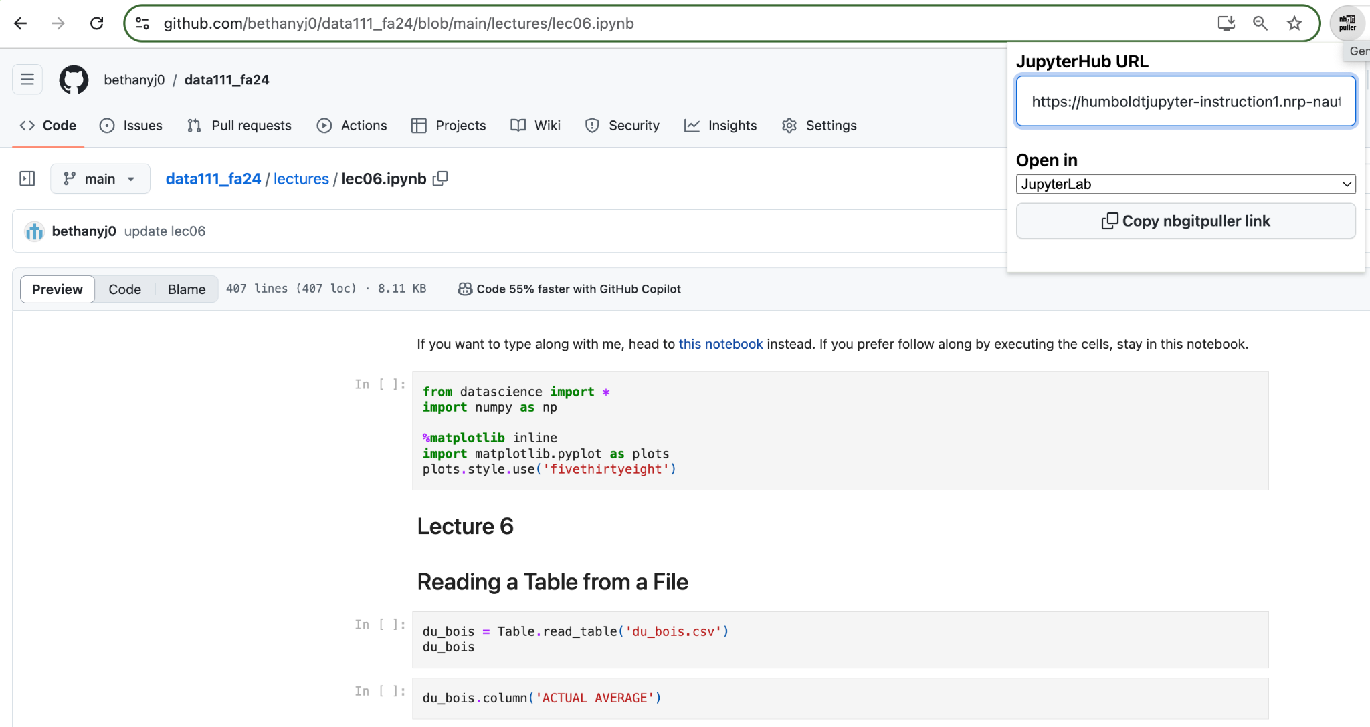
Technology: JupyterHub

Slide 7
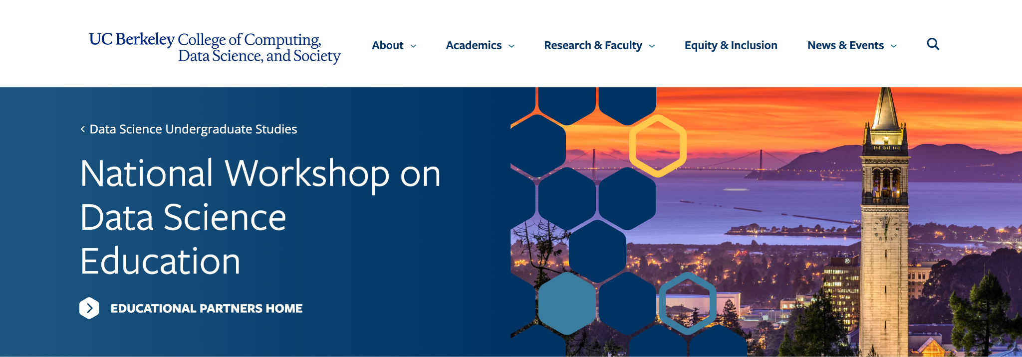
My training
Technical: Related concepts through applied math PhD research
Instructional: National Workshop on Data Science Education

Slide 8
How has Cal Poly Humboldt Included Data Science?
Created new data science major
Infused existing courses with data science
First-year level STEM course
Calculus I

Slide 9
Data Science Major at Cal Poly Humboldt
Computational skills to extract different types and quantities of data from multiple sources and create visualizations and other data products for various audiences;
Statistical knowledge to build mathematical models and ensure the validity of data and its analysis;
Domain knowledge in one or more key areas of application to gain domain specific information from data and its analysis and to communicate insights from that data that support understanding of and solutions for critical problems within the domain;
Contemporary computer-based and data-oriented analytical skills and related ethical considerations to support a broad synthesis of knowledge including contributions from humanities, natural sciences, traditional ecological knowledges, and other foundational frameworks for understanding.

Slide 10
Our Major
Advisor-approved set of at least 15 units in an area of application. At least 9 units must be upper division
Advanced Data Science Methods and Ethics
Data Science Capstone
Applied Data Analysis
Machine Learning for Data Science
Students choose 1 upper division stats class
Probability and Statistics
Linear Regression
Multivariate Statistics
Sampling Design and Analysis
Modern Statistical Modeling
Advisor approved statistics course in area of application
Database Design
Data Wrangling and Visualization
Calculus II
Math, CS, or Stats
Data Science
Computer Science Foundations
Intro to Data Science
Intro to Linear Algebra
Intro to Stats for Life Sciences
Calculus I
Area of Application

Slide 11
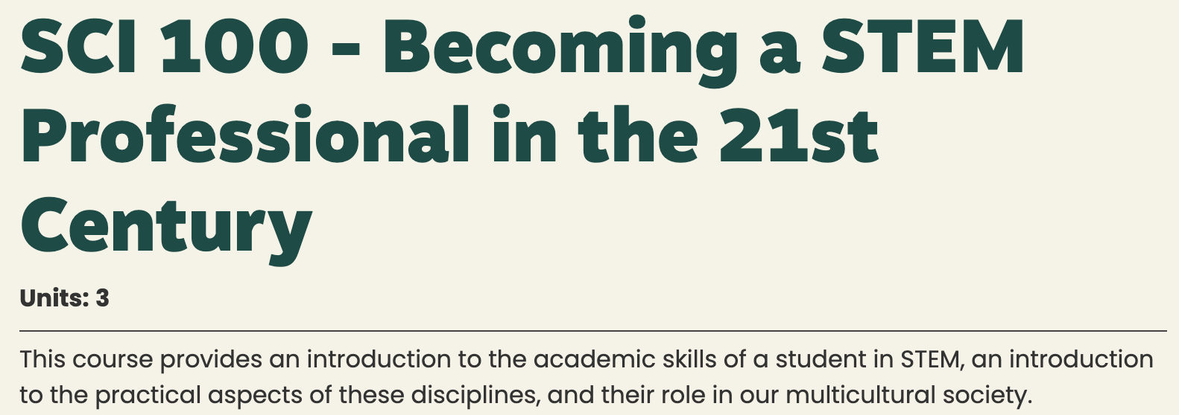

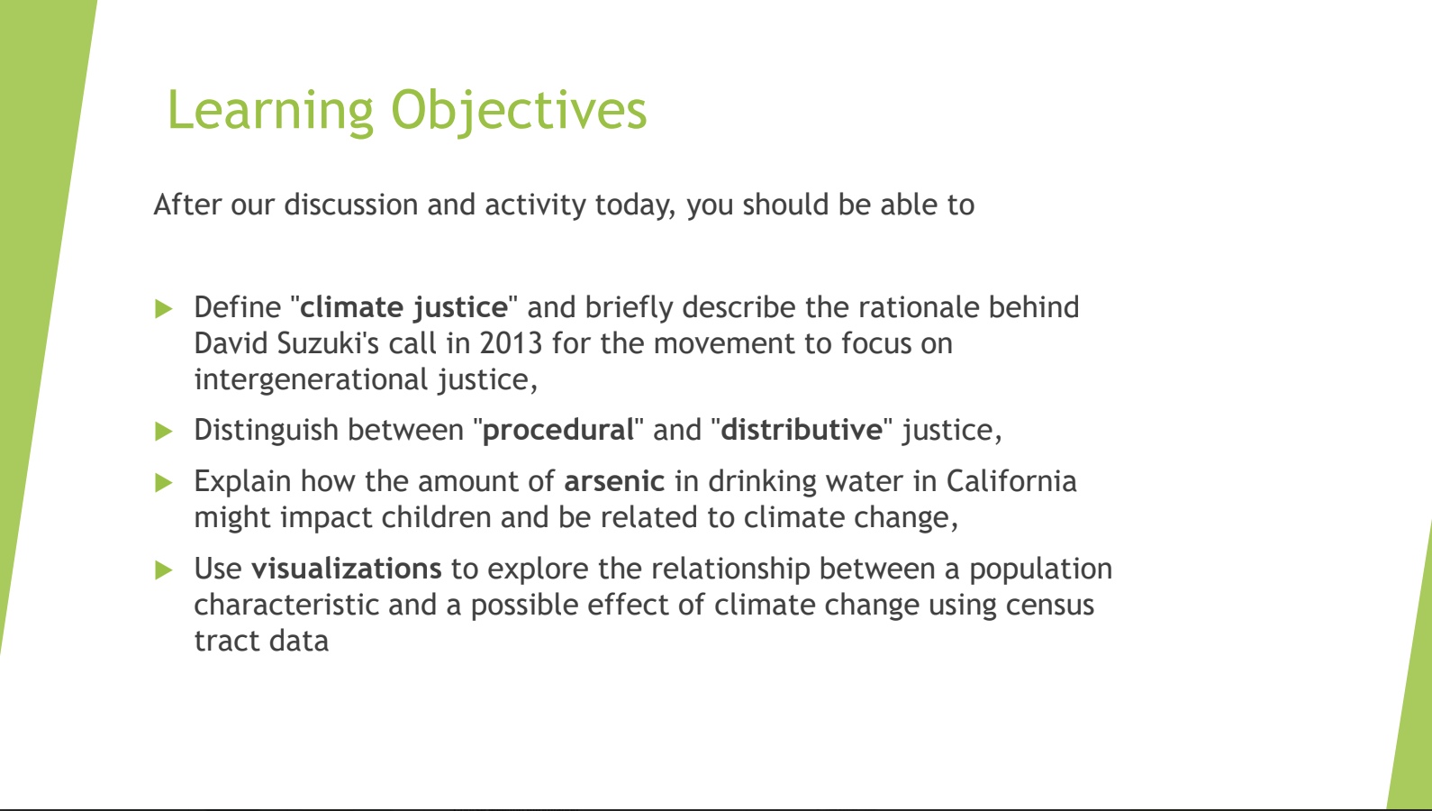
Infuse Existing courses with Data Science: Example 1
Data Science modules in first-year STEM course

Slide 12
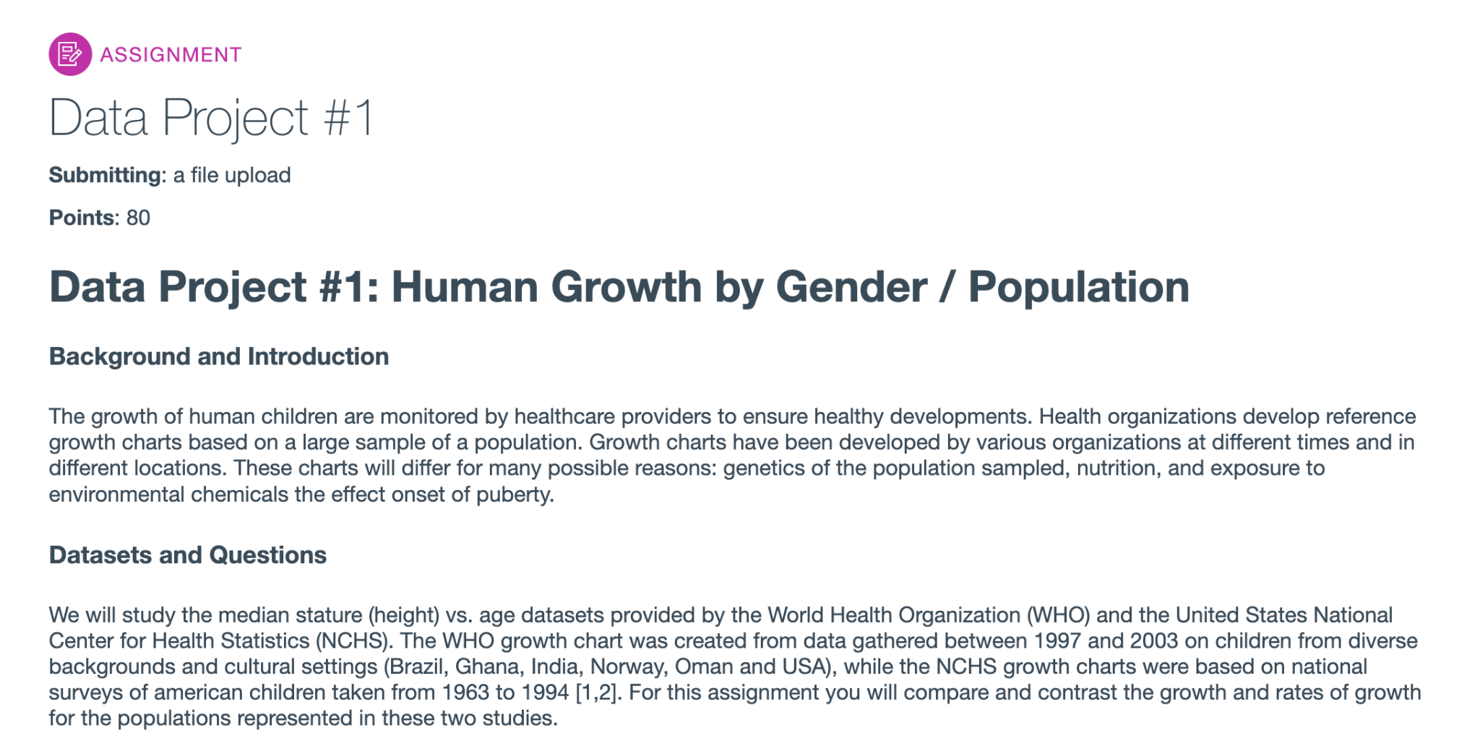
Infuse Existing courses with Data Science: Example 2
Data Projects in Calculus I

Slide 13
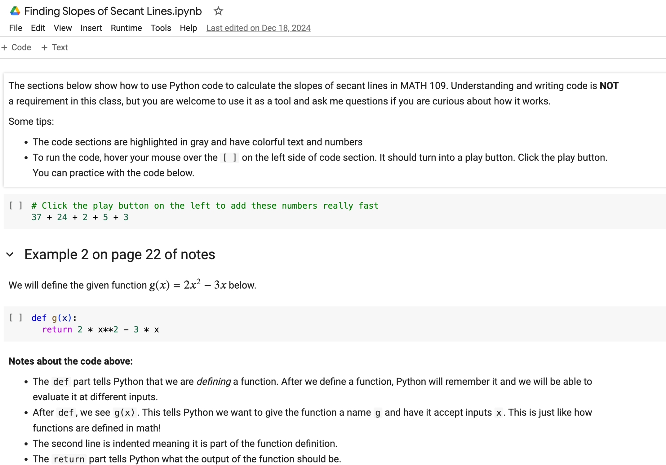
Infuse Existing courses with Data Science: Example 3
Python programming with Jupyter Notebooks in Calculus I

